Slide 1


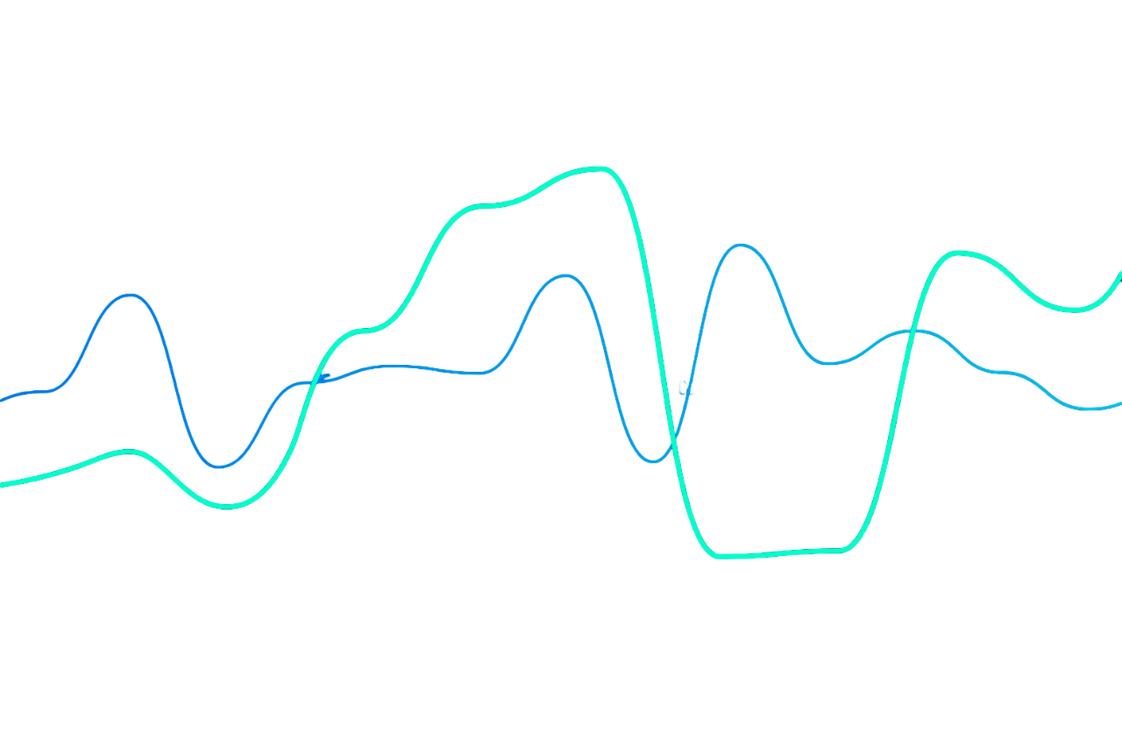

Stock Price Prediction Using Machine Learning
Presentation
Sameer Mohammad Mansoori
IIT Madras

Slide 2









Table Of Contents
Introduction
Data and EDA
Features
Models
Evaluation
Results
Hypothesis
Conclusion

Slide 3


1
Introduction
Importance of Machine Learning in Stock Price Prediction

Slide 4
Revolutionizing Stock Forecasting
Time Series Efficiency
Predictive Power
Machine learning has transformed stock price prediction by offering sophisticated tools that can analyze vast, complex data to predict future trends with greater accuracy.
Algorithms such as LSTM handle sequential data, making them ideal for stock price prediction based on historical trends and market conditions
Machine learning captures short-term and long-term market behaviors, enabling more precise forecasts of price movements and trend

Slide 5
Enhanced Accuracy
Adaptability
Improved Investment Decisions
Machine learning models, like LSTM, demonstrate over 93% accuracy, outperforming traditional methods in stock price forecasting
ML models can process large, nonlinear data sets, making them suitable for complex and volatile stock market environments
With high prediction accuracy, machine learning helps investors optimize portfolios and make informed investment choices in volatile markets

Slide 6
2
Data and EDA
Exploratory Data Analyisis on given Dataset

Slide 7
Column Names:
Column Name translation
Data Type COnversion
'日付け': 'Date',
'終値': 'Close price',
'始値': 'Open price',
'高値': 'High price',
'安値': 'Low price',
'出来高': 'Volume',
'変化率 %': '% change'
Date: Date Time Object
Volume: Float
% Change: Float
Outlier Removel
Removed higher that 90 percentile and lower than 10 percentile values from ['Close price', 'Open price', 'High price', 'Low price', 'Volume', '% change'

Slide 8
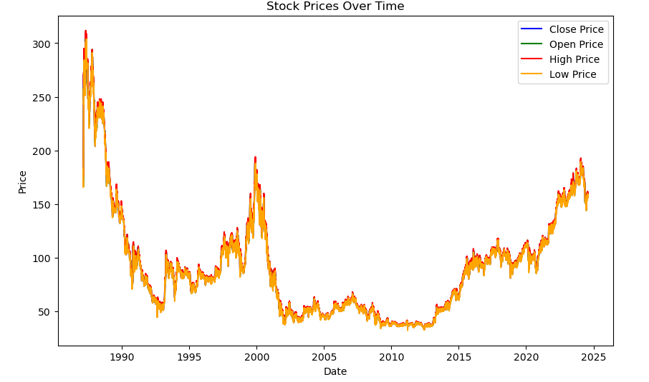
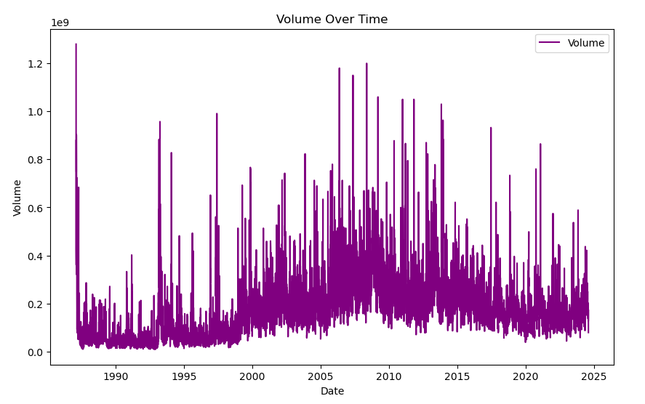

Slide 9
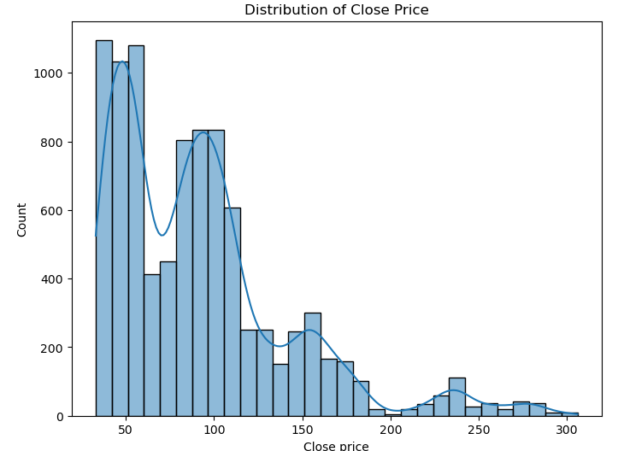
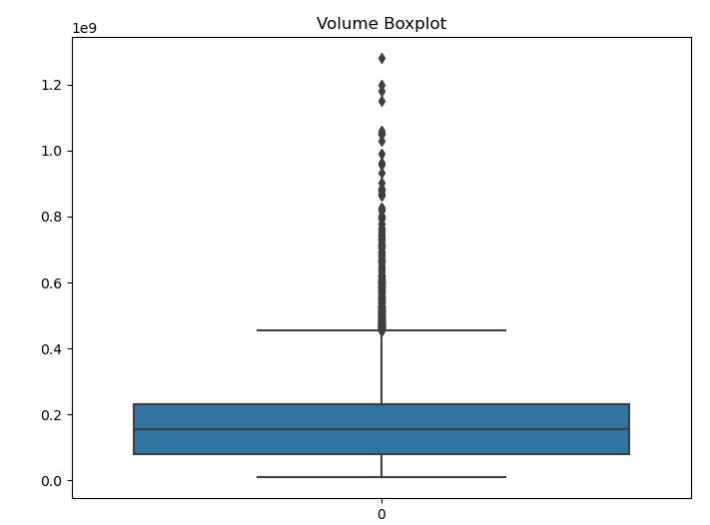

Slide 10
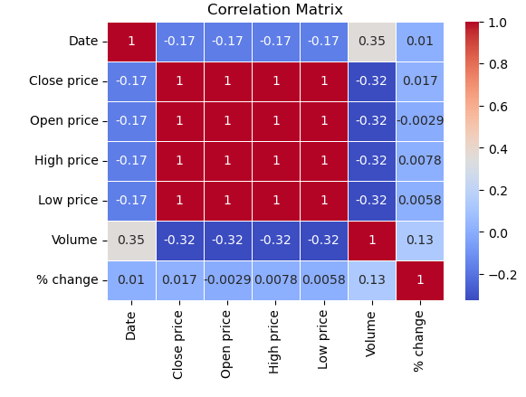
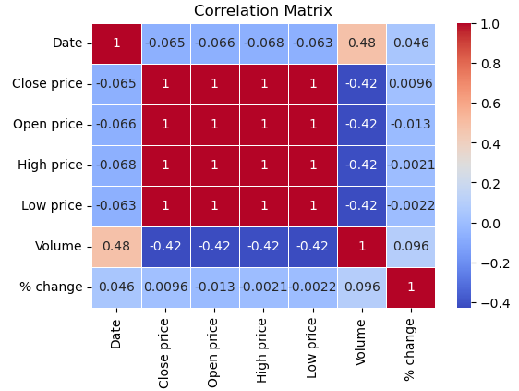
Pearson Correlation
Spearman Correlation

Slide 11
Feature Engineering
3
Selection and building features

Slide 12
Features Engineered
Feature Name | Feature Significance
ema_50 | Exponential moving average of last 50 days closing price
volatility_30 | The standard deviation of last 30 days closing price
ema_12 | Exponential moving average of last 12 days closing price
ema_26 | Exponential moving average of last 26 days closing price
MACD | Moving Average Convergence and Divergence
Rolling Mean | Rolling mean of last 30 days
bollinger_upper | upper band is found by adding two standard deviations to the center SMA line
bollinger_lower | lower band is calculated by subtracting two standard deviations from the center line
rsi | Relative Strength Index (RSI) is a technical analysis indicator that measures the price momentum of a security or stock
Day of week | Day number of the week (0 to 6)
monrth | Month number of the year(0 to 11)

Slide 13
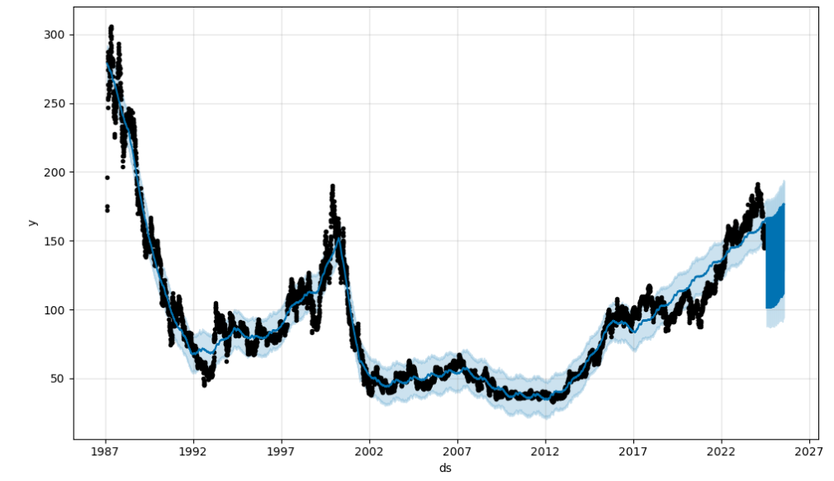
Prophet Results

Slide 14
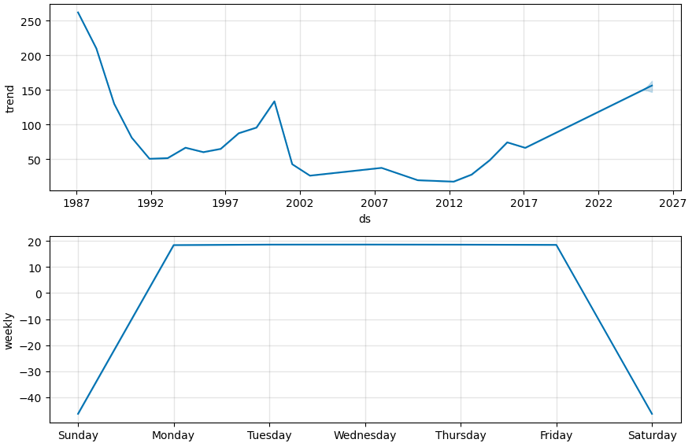
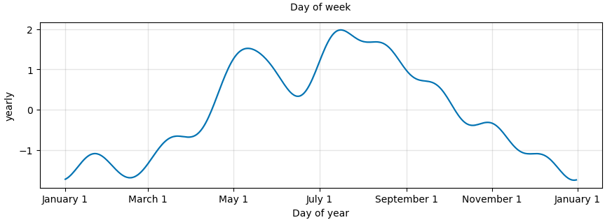
Prophet Results

Slide 15
Feature Elimination
Feature were Eliminated using correlation matrix
Some features were removed by multicollinearity with others features
Visualising patterns with closing price shortlisted some features

Slide 16
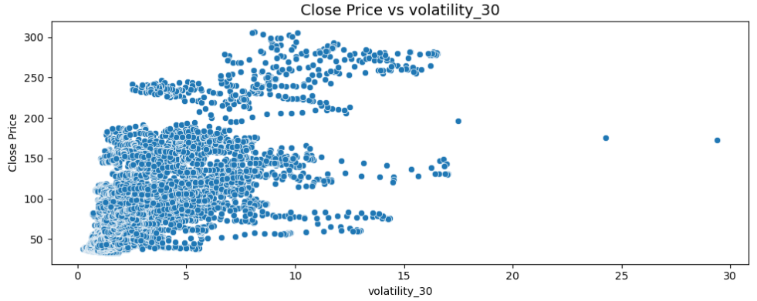
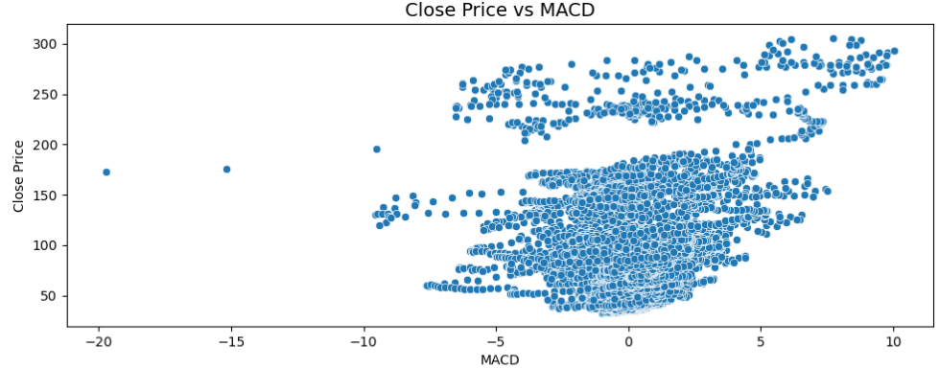
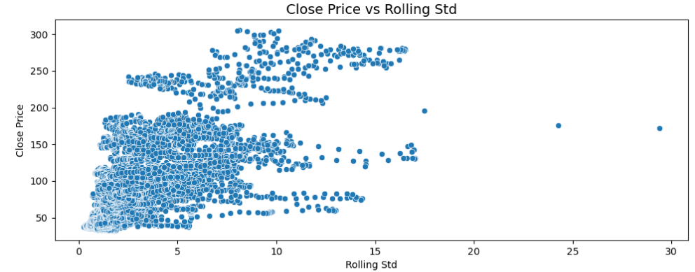
Features patterns

Slide 17
Prophet Results
Feature Name | Feature Significance
ema_50 | Exponential moving average of last 50 days closing price
volatility_30 | The standard deviation of last 30 days closing price
ema_12 | Exponential moving average of last 12 days closing price
ema_26 | Exponential moving average of last 26 days closing price
MACD | Moving Average Convergence and Divergence
Rolling Mean | Rolling mean of last 30 days
rsi
Day of week | Day number of the week (0 to 6)
monrth | Month number of the year(0 to 11)

Slide 18
Models
4
Building Deep Learning Models

Slide 19
LSTM Model 1
Input: 100 days moving average
Model Overview: Sequential Model: A stacked LSTM architecture for time series prediction.Layers: The model consists of four LSTM layers with increasing units and dropout layers to prevent overfitting.

Slide 20
LSTM Model 1
Layer Breakdown:
LSTM Layer 1: 50 units, ReLU activation, return_sequences=True, Dropout 0.2
LSTM Layer 2: 60 units, ReLU activation, return_sequences=True, Dropout 0.3
LSTM Layer 3: 80 units, ReLU activation, return_sequences=True, Dropout 0.4
LSTM Layer 4: 120 units, ReLU activation, return_sequences=False, Dropout 0.5
Dense Layer: Output layer with 1 unit for regression
Model Compilation: Optimizer: AdamLoss
function: Mean Squared Error

Slide 21
LSTM Model 2
Input: 8 shortlisted features
Model Overview: Sequential Model: A stacked LSTM architecture for time series prediction.Layers: The model consists of four LSTM layers with increasing units and dropout layers to prevent overfitting.

Slide 22
LSTM Model 1
Layer Breakdown:
LSTM Layer 1: 50 units, ReLU activation, return_sequences=True, Dropout 0.2
LSTM Layer 2: 60 units, ReLU activation, return_sequences=True, Dropout 0.3
LSTM Layer 3: 80 units, ReLU activation, return_sequences=True, Dropout 0.4
LSTM Layer 4: 120 units, ReLU activation, return_sequences=False, Dropout 0.5
Dense Layer: Output layer with 1 unit for regression
Model Compilation: Optimizer: AdamLoss
function: Mean Squared Error

Slide 23
LSTM Model 3
Input: 8 shortlisted features
Model Overview: Sequential Model: A stacked LSTM architecture for time series prediction.Layers: The model consists of four LSTM layers with increasing units and dropout layers to prevent overfitting.

Slide 24
LSTM Model 3
Layer Breakdown:
LSTM Layer 1: 50 units, Tanh activation, return_sequences=True, Dropout 0.2
LSTM Layer 2: 60 units, Tanh activation, return_sequences=True, Dropout 0.3
LSTM Layer 3: 80 units, Tanh activation, return_sequences=True, Dropout 0.4
LSTM Layer 4: 120 units, Tanh activation, return_sequences=False, Dropout 0.5
Dense Layer: Output layer with 1 unit for regression
Model Compilation: Optimizer: AdamLoss
function: Mean Squared Error

Slide 25
Evaluation
5
Evaluating All three models

Slide 26
Metrics
Evaluation Metric: ‘Mean Squared Metrics’ are used to build the model
Plots between acutal v/s predicted values are also used as evaluation

Slide 27
Results
6
Results of the all three models

Slide 28
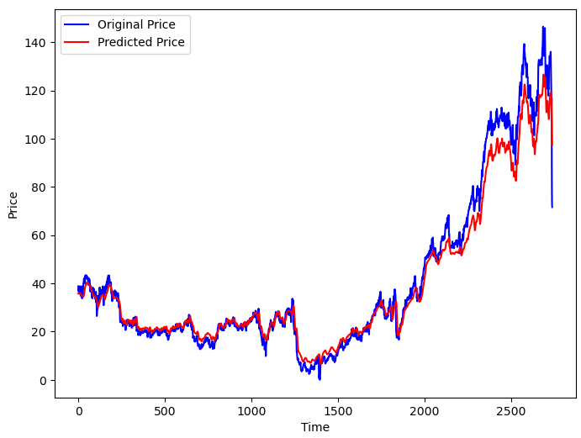
LSTM Model 1

Slide 29
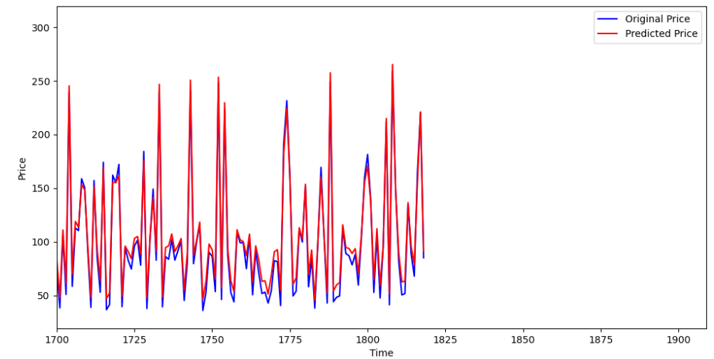
LSTM Model 2: mse=76

Slide 30
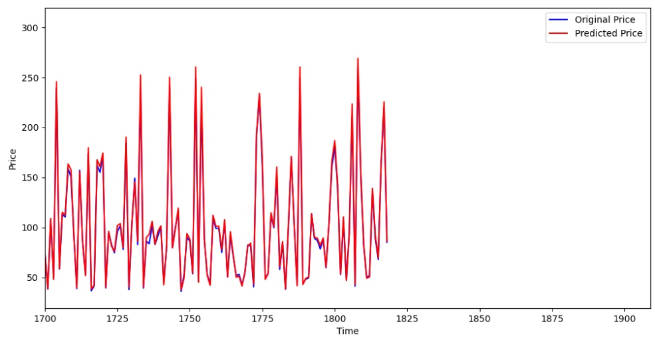
LSTM Model 3: mse=15

Slide 31
Hypothesis
7
Results of the all three models

Slide 32
Using last 100 day’s closing price as a input is features is slow but accurate
Using self built features are faster and more accurate
Using tanh as activation function boosted the performance mse 76 to 15.

Slide 33
8
Conclusion

Slide 34
Effective Time Series Prediction: LSTM models, due to their ability to process sequential data, proved highly effective for stock price prediction based on historical trends.
Performance Comparison: Among the models, the LSTM with Tanh activation achieved the lowest mean squared error (MSE = 15), demonstrating superior performance.
Investment Applications: The models, particularly the optimized LSTM, show strong potential for aiding investors in making informed decisions by predicting stock market trends with high accuracy.

Slide 35
Thank you!

